Slide 1
American Literary Movements Timeline

Slide 2
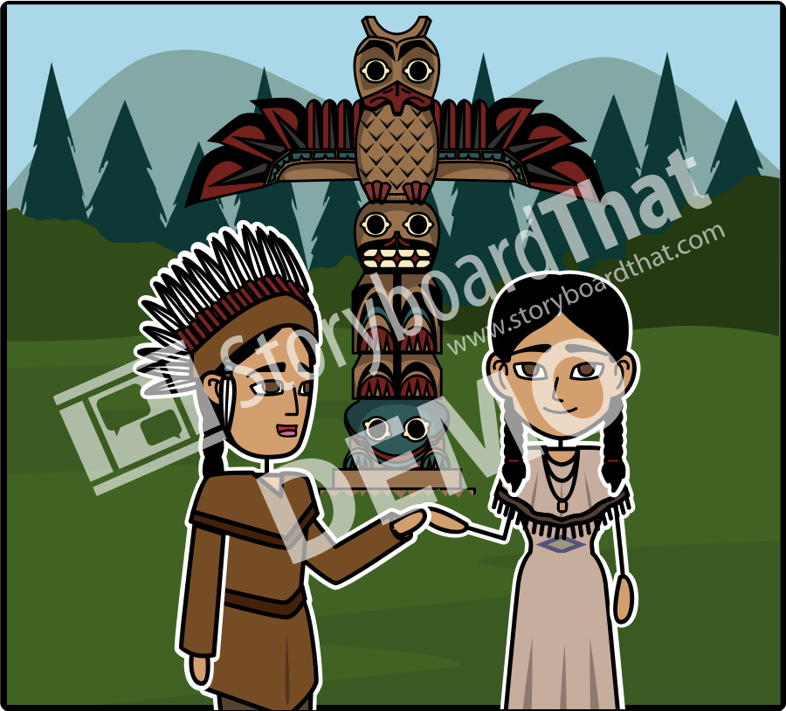
Native American (Before 1600)
Characterized by oral traditions, epic poems, creation myths, songs, and poetry. Native American literature has been around long before the settlers arrived. Recently​, authors like Sherman Alexie have revived stories of American Indians​ with his stories, which give insight into life on the reservation.

Slide 3
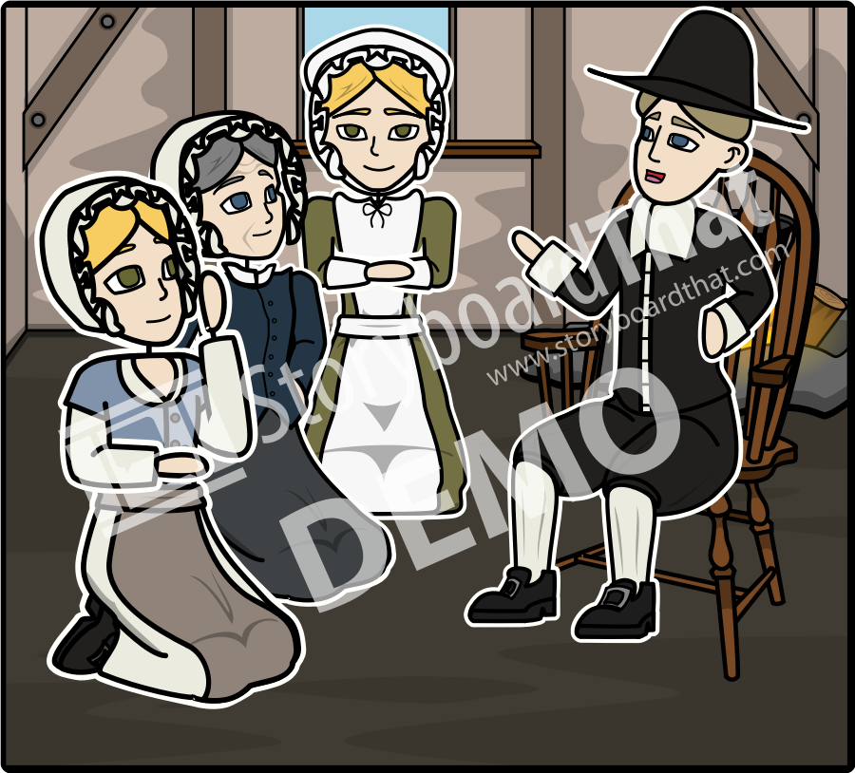
Puritanism or Colonial (1620-1750)
Characterized by their desire to 'purify' the Church of England with the simple worship of God, Puritans left England to colonize the new world. As settlers, they recorded their experiences through diaries and historical accounts. ​

Slide 4
Revolutionary, Age of Reason, Enlightenment (1750-1800)
Characterized by human desire to understand the world around them through reason rather than faith. This era was mostly composed of philosophers and scientists whose writing sparked an enlightenment in thought.

Slide 5
Romanticism, American Gothic (1800-1865)
This era valued feeling, intuition, and idealism. It placed faith in inner experience and imagination​. Individual freedom and the worth of the individual was paramount, and poetry was seen as the highest expression of the mind. Dark Romantics or American Gothic writers used dark supernatural themes and settings.

Slide 6
Transcendentalism (1840-1860)
Transcendentalists advocated self-reliance and individualism over authority and conformity to tradition, believing institutions and organizations were responsible for corrupting the inherent goodness of people. ​​In their writing, transcendentalists commonly reflected on nature, a unified “divine spirit”, common to all people, and community.

Slide 7
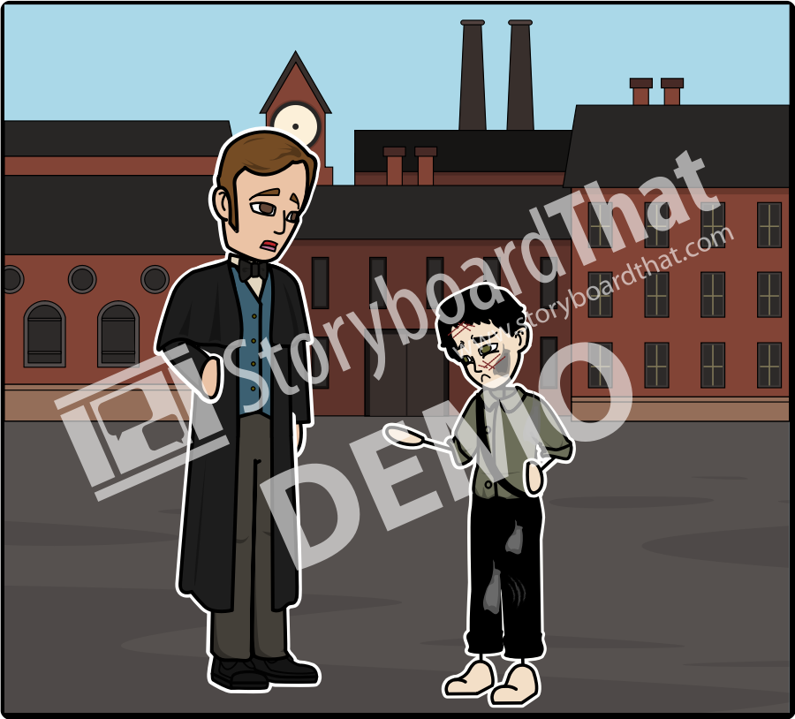
Realism, Naturalism & Regionalism (1865-1914, 1930, 1895)
This movement was marked by feelings of disillusionment. Familiar subjects included ghettos of rapidly growing cities, the industrial revolution, and corrupt politicians. Authors focused on painting a realistic setting of everyday life and ordinary people, including local color, while also seeking to explain human behavior. ​

Slide 8
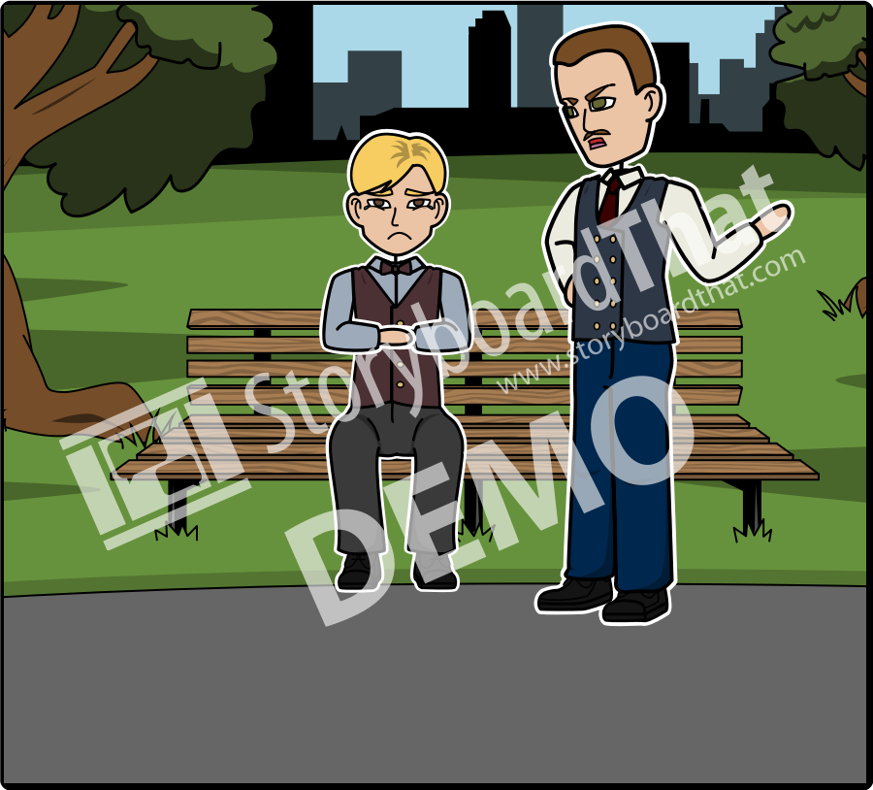
Modernism (1914-1945)
Beginning as an extension of realism, this era broke with literary and poetic traditions. Authors were bold and experimental in style; an example being “stream of consciousness”. Modernist literature can seem bleak, but is characterized by the optimistic belief that people can change the world around them.

Slide 9
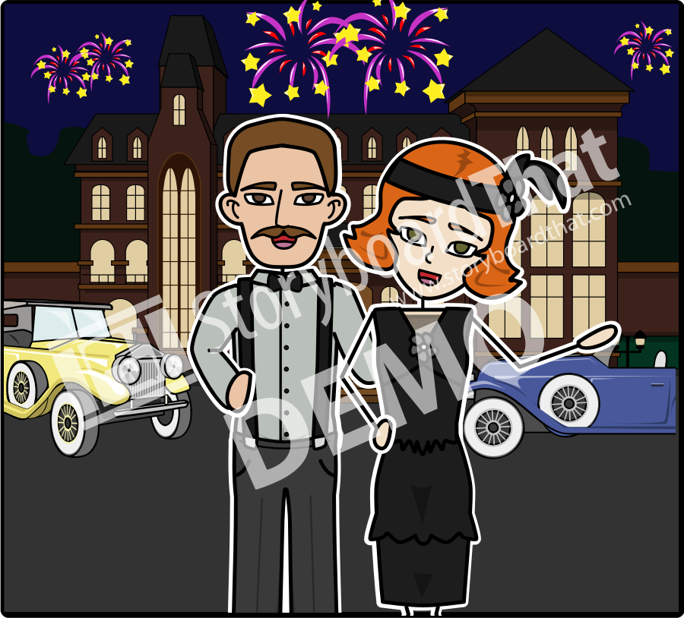
Lost Generation, Jazz Age, Roaring 20’s & The Harlem Renaissance (1917-1937)
African American culture in Harlem, New York was flourishing. Much of the style derived from poetry rhythms based on spirituals, and jazz lyrics on the blues, and the use of slang in everyday diction. These influences intersected with prohibition, reactions to WWI, and the sultry nightlife of the big city to produce an energetic progressive culture.

Slide 10
Contemporary/Postmodernism
(1950-Present)
Literature in this period was influenced by studies of media, language, and information technology. It is marked by the fact that nothing is truly "unique" and the conception that our culture endlessly duplicates itself. New literary forms and techniques focused on intense dialog, a blend of fiction and​ nonfiction, and the overall appearance of the work.

