Slide 1
Differentiating Between Themes and Central Ideas

Slide 2
Themes reside in fiction

Slide 3
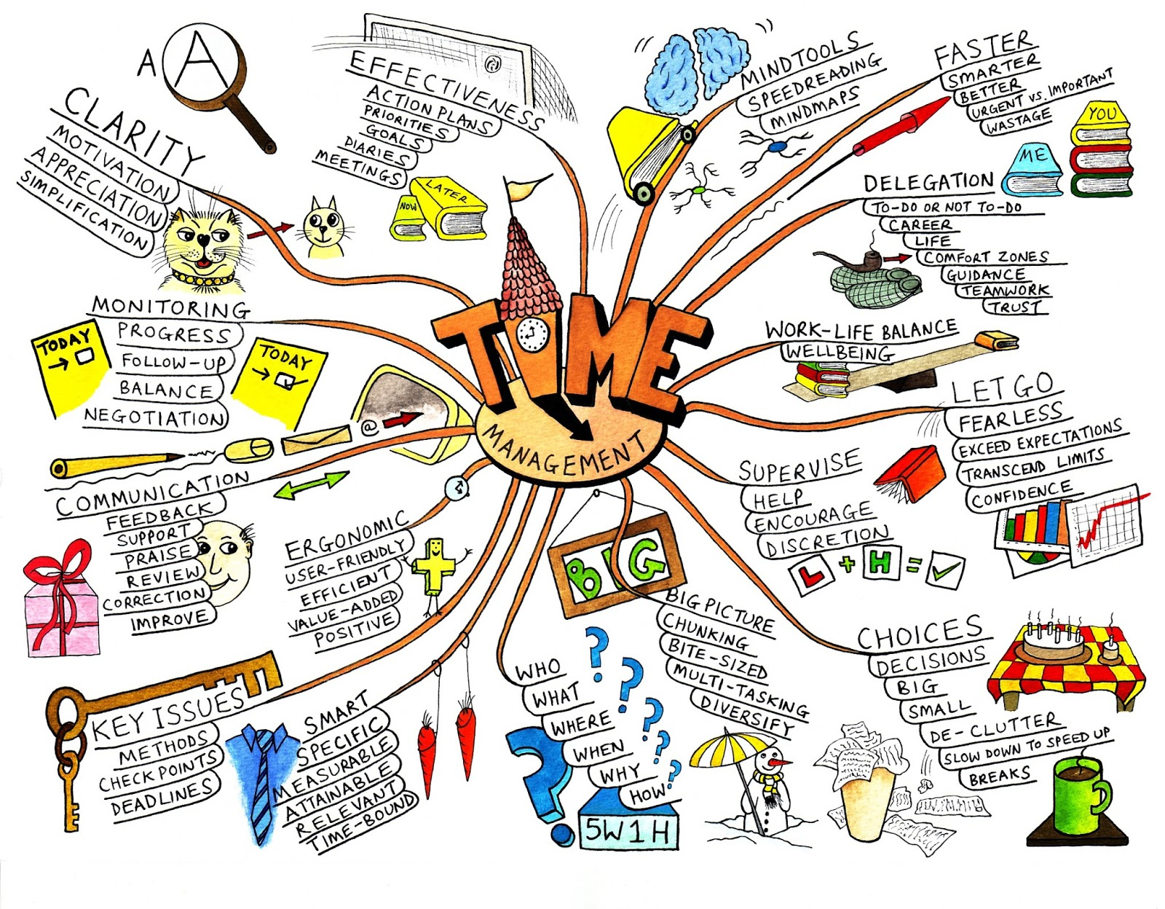
Central ideas reside in nonfiction

Slide 4
Fiction only
Determine a theme of a text and analyze its development over the course of the text, including its relationship to the characters, setting, and plot; provide an objective summary of the text.

Slide 5
Determining Themes in Fiction
A theme is a message about life or an insight into life.
It can be stated in the text or inferred by the reader
Themes are developed through characters’ decisions, experiences, interactions, and insights.

Slide 6
When looking for themes, remember the two approaches
Stated theme: expressed directly in the text by the writer.
Implied themes revealed gradually through elements such as plot, characters, setting, point of view, symbol, and irony.

Slide 7
Example
Story Details
Alex demands that Bob and Jake bully Ryan.
Jake refuses. Bob bullies Ryan but feels bad afterward.
Implied Theme
Stay true to your own values.
Generalization from details
People who act against their better judgment may feel bad afterward.

Slide 8
Details, Generalization, Implied Theme
A man went to a fancy party where he, along with several other guests, was to be honored. Dressed in ordinary clothes, the man was overlooked—no host greeted him, no guests chatted with him, no servants served him. The man went home, put on his best clothes, and returned to the party. Now the host introduced himself and commanded the servers to bring food to the man. When the man offered the food to his dress coat, the host was puzzled. The man explained that his clothes should have the food, since the host was actually honoring them.

Slide 9
Example
Story Details
Man attending party, mention of the clothing being ordinary, changing of outfit, treatment of the man after changing
Generalization
The host and servants respond to clothing.
Implied Theme
People should be judged by their character, not their clothing.

Slide 10
Nonfiction only
Determine a central idea of a text and analyze its development over the course of the text, including its relationship to supporting ideas; provide an objective summary of the text.

Slide 11
Determining Central Ideas in Nonfiction
Nonfiction works develop central ideas through use of support details.
A central idea is a key point the author wants to make.
All the details in the text develop and support the central idea by: proving it, explaining it, illustrating it, and detailing it

Slide 12
Determining Central Ideas
Stated Central Ideas
In most cases, the author directly states the central idea near the beginning of the text.
Inferred Central Ideas
When central ideas are implied by points the author makes.
Readers can infer by determining what point all of the details support when pieced together.

Slide 13
The Role of the Paragraph
Each paragraph develops its own main idea.
Topic sentence is supported by reasons, examples, and other details.
This is used to support the main idea of the whole text.
Main idea of a paragraph is often stated in a topic sentence.

Slide 14
The Role of the Paragraph
Tying up the pieces to formulate Central Ideas:
All details in each paragraph, as well as each paragraph itself, serve the larger purpose of developing the central idea of the whole work.

Slide 15
Central Idea
How a text’s central idea is developed is directly related to the author’s purpose for writing:
* To Inform
* To Entertain
* To Persuade

Slide 16
Rock climbing is dangerous.
To inform
To persuade
To entertain
Include facts about accidents
Add arguments about the need for safety
Include comical details about a rock climbing experience.

